Slide 1

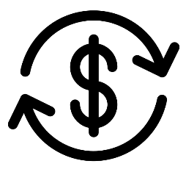
Highlights of the City of Madison’s 2022 Budget
Homeless Services Consortium
Tuesday, November 16, 2022
Icons from the Noun Project. business cycle by Tinashe Mugayi

Slide 2
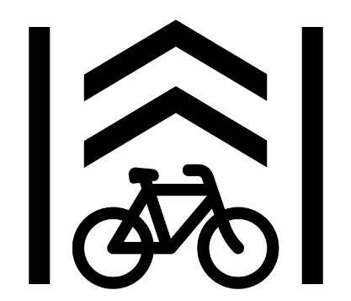
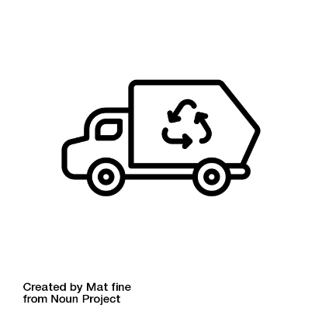
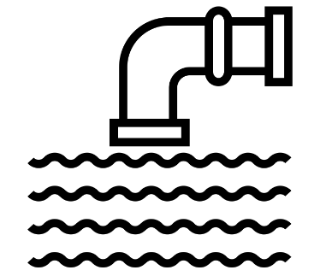
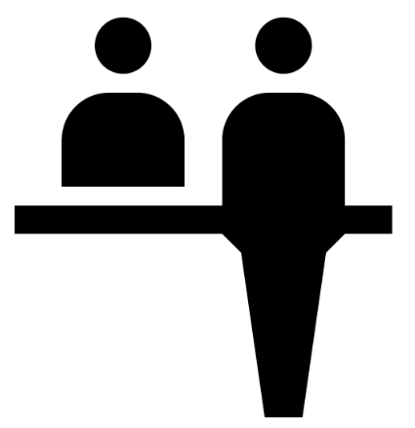

Budget 101
The City has two budgets: the capital budget and operating budget. Both are planning documents that outline and authorize how the City will spend money in the upcoming year.
Capital Budget
Operating Budget
Funds physical infrastructure like roads, bike lanes, building improvements, and affordable housing.
Investments ensure infrastructure is safe and advancing goals on climate change, housing, and other issues.
Primarily paid for through borrowing. Special assessments, impact fees, user fees and federal and state grants also help finance capital projects.
Pays for daily services to City residents by paying salaries of staff, funding community organizations who deliver services on behalf of the City, and other costs.
Funding ensures residents have access to core city services.
Primarily funded by property taxes.
Charges for services, user fees, and federal and state aid also contribute to the budget.
Icons from the Noun Project. Bike Lane by Pierre-Luc Auclair; sewage pipe by Vectors Point; Garbage Truck by Mat fine; reception by Sascha Elmers
Notes:
Dave

Slide 3
Annual Budget Development Timeline
(Capital + Operating)
Each year starts with a “Cost to Continue” projection. This is how much it would cost to provide the same level of service next year.
Council can submit amendments to the executive budget and has final authority to approve the budget.
2. April – July:
Agencies develop Capital and Operating Budget
3. July – August:
Mayor prepares Executive budget
4. Sept. – Nov.:
Finance Committee hearings
1. January – March:
Cost to Continue
Priority Setting
Public Participation in the Budget Process:
City staff frequently engage residents to understand service needs – through Neighborhood Resource Teams, resident surveys, participation in planning processes, and other approaches. This is a key input into budget priorities.
Members of the public can also participate in the budget by providing public testimony at budget hearings in the fall.

Slide 4
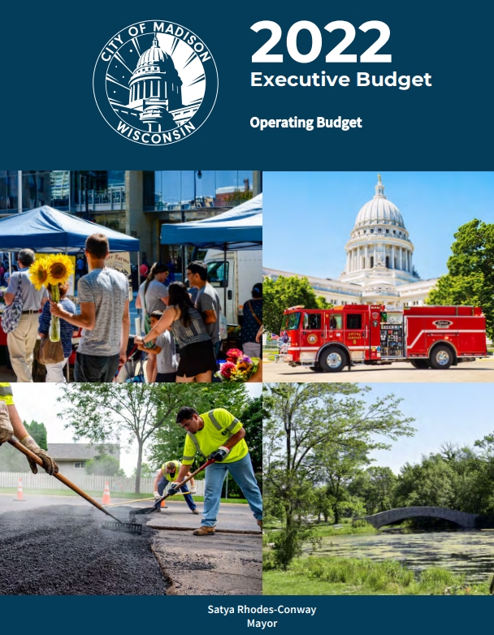
Where to find the budget online: https://www.cityofmadison.com/budget

Slide 5
Adopted Operating Budget = $360 Million
General and Library Fund Expenses
Funding for homelessness services and affordable housing are included in general fund and non-general fund expenditures.
General Fund
$2.16m for Homeless and Tenant Services
$50k for homebuyer education contract
$75k to fund a community plan to end homelessness
American Rescue Plan Act (ARPA)
$1.5m for unsheltered homeless support (in addition to $2m allocated in 2021)
$1m for Renter’s Choice: Reducing Barriers to Renting
$2m for an endowment for homelessness operating services
CDBG and HUD
$1 m for Housing Supply (CDBG)
$1.7 for Housing Assistance (CDBG)
$9.5m for CDA Public Housing operations
$19.6m for CDA Section 8 housing vouchers

Slide 6
Other Priority Areas
Town of Madison: $1.4 million in funding to support equitable services
  Additional positions in Assessor, Police, and Streets
  Centrally budgeted transition costs
  Non-personnel costs for tax bills, parks maintenance, planning & communications, and police
Violence Prevention and Public Safety: Investments across multiple agencies to support holistic violence prevention (VP) efforts and advance innovation and accountability in public safety
  $1 million in ARPA funds for Public Health VP initiatives
  $1.6 million for CDD youth employment programs
  $600k to continue cross-agency CARES program
  Full funding for Office of Independent Monitor
  MPD Reform and Innovation Initiatives
Diversifying Workforce: Investing in trainee programs in Engineering, Parks, and Streets to recruit and train diverse candidates
  New position in both the operating and capital budgets

Slide 7
Adopted Capital Budget = $354 Million
Investments in homelessness services and affordable housing include:
Affordable Housing – Consumer Lending ($3.7m in 2022)
Affordable Housing – Development Loans ($7m in 2022)
Hotels Converted to Housing ($1.5m in 2022)
Permanent Men’s Shelter ($4m in 2022, including County funds)
Salvation Army Darbo Site ($2.5m in 2022)
Youth-Centered Housing ($2m in 2022)

Slide 8

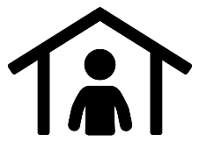



Other Investments Using American Rescue Plan Act (ARPA) funds
Violence Prevention and Youth Engagement
Homelessness Support
Affordable Housing
$2,585,000
Funding supports youth employment, violence prevention initiatives, and evaluation of the CARES alternative crisis response team.
$8,650,000
Funding support a variety of strategies to support persons experiencing homelessness including a permanent shelter and additional tiny homes.
$6,650,000
Funding expands low-cost housing choices, supports a tenant assistance fund, and expands housing assistance to Madison residents.
Neighborhood and Small Business Support
Basic Needs and Emerging Issues
$3,915,000
Funding increases grants to small businesses, supports neighborhood business districts, and brings art to vacant storefronts downtown.
$1,000,000
Funding helps members of our community, including undocumented residents and seniors, gain access to services that meet their basic needs.
Icons from the Noun Project. social network by Icon Market; Shelter by Adrien Coquet; Housing by Made x Made; storefront by Dylan Thompson; care by Pavitra

