Slide 1
Built for Zero Update
November 6, 2018
Torrie Kopp Mueller, CoC Coordinator

Slide 2
Quick Recap
Local participation began in 2015
Coordinated by Community Solutions
Rigorous national change effort designed to help a core group of committed US communites end chronic and veteran homelessness
There are 64 Built for Zero Communities
Now looking at youth, family and non-chronic adult homelessness
Looking into racial disparity data

Slide 3
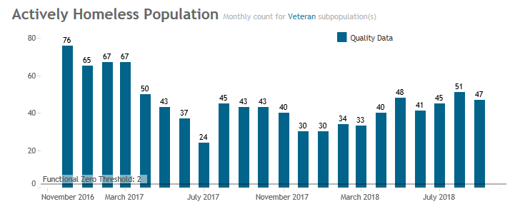
Veterans Experiencing Homelessness

Slide 4
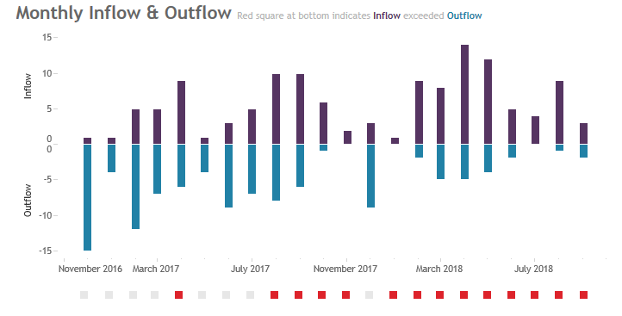
Veteran Inflow & Outflow

Slide 5
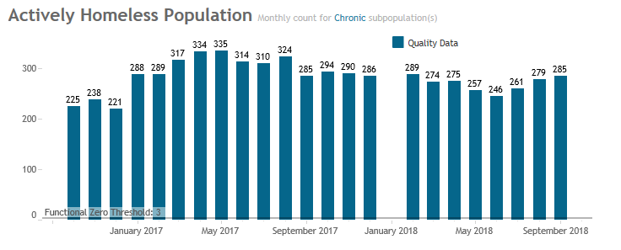
Single Adults Experiencing Chronic Homelessness

Slide 6
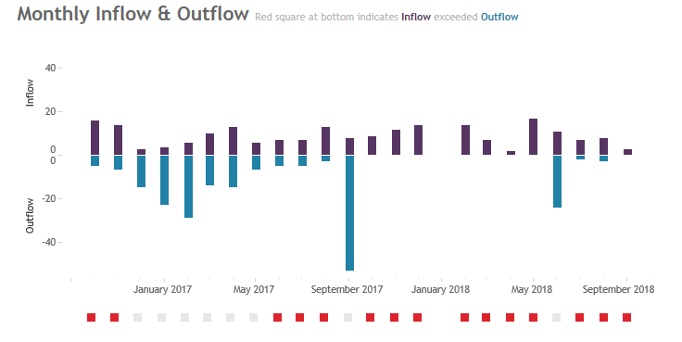
Inflow and Outflow: Chronic Homelessness

Slide 7
Housing Priority List: Current Numbers
Single Adults: November 5, 2018
Families: November 5, 2018

Slide 8
Update on Projects
1. Reduction in behavior related transfer requests.
2. Redo the Built for Zero By-Name List Scorecard.
3. Build the Will event.

Slide 9
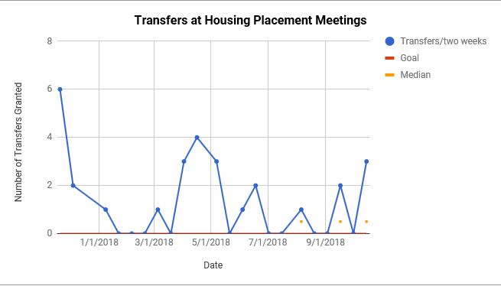

Slide 10
October Learning Session: Detroit, MI
Local Team Attendees: Torrie Kopp Mueller, Sarah Anderson, Angel Kinnie, Brenda Konkel
Set a Functional Zero Goal for Veterans:
Madison/Dane County CoC will be down to 24 Veterans on the list in September 2019.

Slide 11
Projects
1. Match Veterans with appropriate level of housing services.
2. Have clear communication between VA, SSVF and Coordinated Entry.
3. Fully utilize all Veteran resources available (including SSVF and Honorbound).

